Slide 1





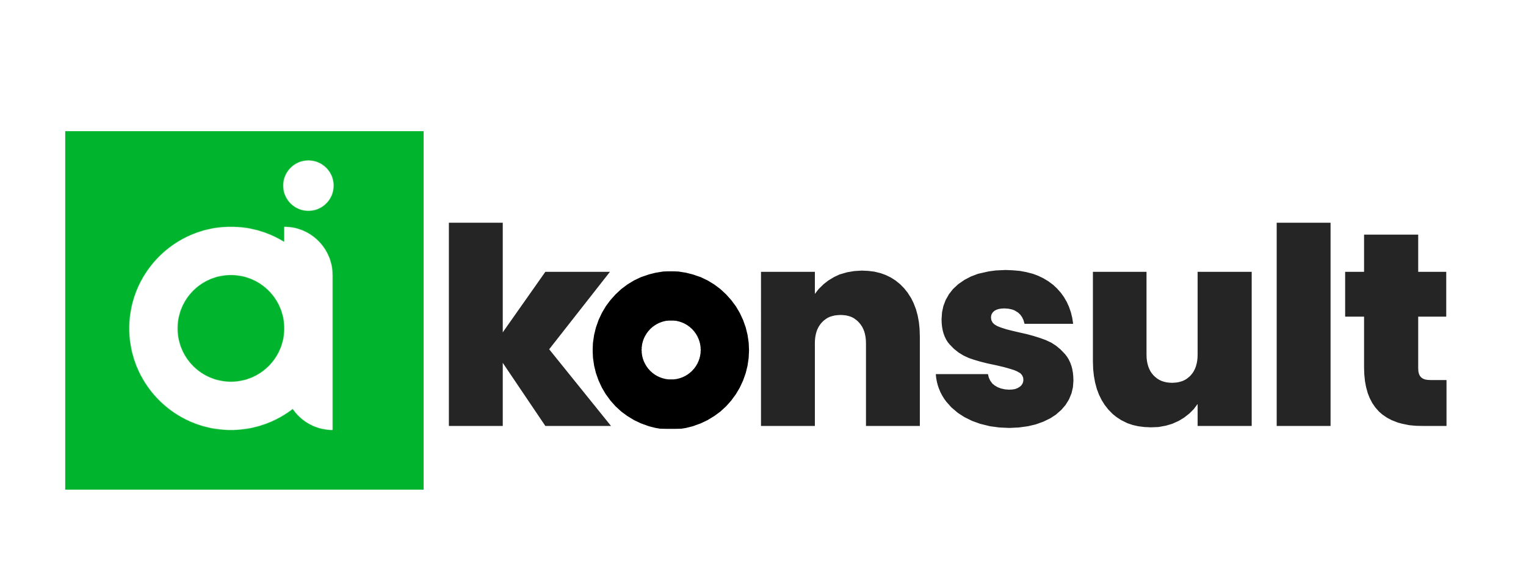
CONTENTS
BUSINESS OVERVIEW
DATA ANALYTICS
ESG & INTEGRATED REPORTING
MARKETING
BUSINESS DEVELOPMENT
BUSINESS TRANSFORMATION
CORPORATE GOVERNANCE
eHEALTH
ADVISORY SERVICES
Integrity
We champion transparency, are independent, demonstrate honesty, ethical action & principles, fostering a trustworthy environment for our clients & team.
Curiosity
Our culture thrives on curiosity. We seek knowledge, challenge norms, ask the right questions & embrace innovation.
Excellence
Excellence is our commitment in all endeavors. We aim to surpass expectations, refining our craft & delivering outstanding results with every project. We put our clients first.
A DIVISION OF ARTIFICIAL INTELLIGENCE (Pty) Ltd BW00002314974

Slide 2








CONTENTS
BUSINESS OVERVIEW
DATA ANALYTICS
ESG & INTEGRATED REPORTING
MARKETING
BUSINESS DEVELOPMENT
BUSINESS TRANSFORMATION
CORPORATE GOVERNANCE
1
About US
AI KONSULT
OUR PURPOSE
Our purpose is to help our clients create change and see the world in a different way. We believe that by leveraging our expertise and experience, we can help our clients build resilience and create high value.
The foundation of our work is solidly laid on meticulous research, data, and analytics.
OUR VISION
Democratizing Excellence.
OUR MISSION
We believe that everyone, regardless of background or circumstances, should have the opportunity to achieve their full potential.
In line with this mission,
Our purpose is to help our clients continuously set new standards of excellence in their respective industries.
WHO WE SERVE
We are committed to engaging with clients whom we can genuinely help.
Prior to establishing a long-term partnership, we prefer to conduct an extensive initial meeting.
This session is crucial for us to gain a comprehensive understanding of your business objectives and to assess how our services align with your needs.
If there is alignment, we dedicate our full-time to your project.
No distractions.
We only focus on your business.
WHO WE ARE
AI Konsult is an integrated business advisory services firm that provides businesses drive growth through emerging technology innovation.
We operate in Botswana, with a global view of the world
We provide an extensive range of services encompassing five key domains:
Customer Experience Management (CXM), Digital Transformation and Disruption, Data Analytics & Reporting, Performance Transformation, and Business Transformation.
No matter if you're a start-up or an established global brand, everyone needs a little extra help on their journey. Let Our Company be the ones that bring success to yours!
OUR SERVICES
Data Analytics, Visualization & Reporting
Business Transformation
Corporate Governance & ESG
Customer Experience Management (CXM)
Strategy
& Analysis

Slide 3

CONTENTS
BUSINESS
OVERVIEW
ENTERPRISE DIGITAL HEALTH STRATEGY
HEALTHCARE DATA ANALYTICS
TELEHEALTH SOLUTIONS
ELECTRONIC HEALTH RECORDS (EHR)
ONLINE PHARMACY
CORPORATE GOVERNANCE
2
“
WELCOME TO
OUR DIVERSE
UNIVERSE
TABLE OF
CONTENTS
Enterprise Digital Health Strategy
Healthcare Data Analytics
HelloDoc: Telehealth Solution
Telehealth Systems Architecture
Business Development
Electronic Health Records
Electronic Data Interchange (EDI)
PharmacyExpress: Online Pharmacy
"To see the world in a different way requires stepping out of familiar thought patterns and embracing new perspectives.
It involves challenging our own biases, actively seeking out diverse viewpoints, and being open to learning from experiences that are different.“
THAT’S OUR UNIVERSE.
Not the same
as something else.
It's a casual way of pointing out that something stands out, doesn't fit the usual pattern, or is unique in its own way.
Distinctive
characteristic or attribute that sets an entity, idea, or strategy apart from others in a competitive landscape.
Departure
from the common or known, often bearing significance in distinguishing lineage, heraldry, or philosophical thought.
Variance or deviation
from a standard, norm, or expected pattern.
THAT’S
WHAT WE WANT
OUR CLIENTS TO EXPERIENCE.
AI KONSULT
Contact Person : Scelo Hlope
Business Lead
Contact Number : (+267) 71-333-551
E-mail: scelo@ai.co.bw
Gaborone Botswana

Slide 4
CONTENTS
BUSINESS
OVERVIEW
ENTERPRISE DIGITAL HEALTH STRATEGY
HEALTHCARE DATA ANALYTICS
TELEHEALTH SOLUTIONS
ELECTRONIC HEALTH RECORDS (EHR)
ONLINE PHARMACY
CORPORATE GOVERNANCE
3
Enterprise Digital Health Strategy
Digital health strategy has become a cornerstone in the modern healthcare industry, representing a comprehensive plan for integrating technology into healthcare delivery to improve patient outcomes, increase efficiency, and stay ahead in a rapidly evolving sector. At its core, a digital health strategy aims to leverage technology to enhance various aspects of healthcare.
This includes the adoption of electronic health records (EHRs) for better data management and patient care, the use of telehealth services to increase accessibility and convenience for patients, and the integration of wearable devices and mobile health apps for continuous patient monitoring and self-management. These technologies not only improve patient care but also streamline operations, leading to significant cost savings and operational efficiencies.
Improving Patient Care: Perhaps the most significant advantage. Digital health technologies like electronic health records (EHRs), telemedicine, wearable devices, and AI-driven diagnostic tools can significantly enhance patient outcomes. They enable more accurate diagnoses, personalized treatment plans, and continuous patient monitoring, leading to better overall patient care.
Enhancing Accessibility & Convenience: Digital health strategies often include the adoption of telehealth services, which greatly increase the accessibility of healthcare, especially for patients in remote areas or those with mobility issues. This also includes easier access to medical records and health information for both patients and providers.
Data –driven decision: A critical aspect of a digital health strategy is its focus on data-driven decision-making. With the vast amount of data generated in healthcare settings, a robust strategy utilizes advanced analytics and AI tools to process and analyze this data. This leads to more accurate diagnoses, effective treatment plans, and predictive health insights, transforming the way healthcare providers approach patient care.
Operational Efficiency & Cost Reduction: Digital health tools can streamline various processes within healthcare organizations, from patient registration to billing. This not only saves time but also reduces operational costs. Automation of routine tasks frees up healthcare professionals to focus more on patient care.
Compliance & Risk Management: With the increasing digitization of health records and use of digital tools, compliance with regulations like HIPAA (in the USA) becomes more complex. A well-defined digital health strategy ensures that all digital initiatives are compliant with these regulations, thereby mitigating legal and financial risks.
Future Readiness & Scalability: The healthcare sector is rapidly evolving, and a digital health strategy prepares organizations for future technological advancements. It ensures that the healthcare provider remains adaptable and scalable in the face of changing healthcare needs and technological innovations.
Competitive Advantage: In addition to improving healthcare delivery, a well-executed digital health strategy offers a competitive advantage. In a healthcare market where patients are increasingly seeking convenient, efficient, and technologically advanced care options, organizations with a robust digital presence are more likely to attract and retain patients.
Collaboration & Communication: Finally, digital health strategies enhance collaboration and communication among healthcare professionals. By providing platforms for sharing information and coordinating care, these strategies foster a more collaborative environment, which is essential for comprehensive patient care.
Enhanced Collaboration & Communication
Improving Patient Care
Competitive Advantage
Enhancing Accessibility
& Convenience
Why You
Need a Digital Health Strategy
Future Readiness & Scalability
Data-Driven Decision Making
Compliance & Risk Management
Operational Efficiency & Cost Reduction
A scalable, adaptable digital health strategy is key to evolving, efficient, patient-centered healthcare in a tech-driven world. the development and implementation of such a strategy transcend mere technology adoption. It involves a comprehensive reformation of healthcare delivery, making it not only more efficient and effective but also significantly more patient-centered, underlining the importance of scalability and adaptability in modern healthcare.

Slide 5


CONTENTS
BUSINESS
OVERVIEW
ENTERPRISE DIGITAL HEALTH STRATEGY
HEALTHCARE DATA ANALYTICS
TELEHEALTH SOLUTIONS
ELECTRONIC HEALTH RECORDS (EHR)
ONLINE PHARMACY
CORPORATE GOVERNANCE
4
Healthcare Data Analytics
AI Konsult specializes in Healthcare Data Analytics, offering a range of analytics services tailored to the needs of various stakeholders in the healthcare sector, including medical aid companies. Our value proposition centers on transforming vast quantities of healthcare data into actionable insights, thereby driving efficiency, improving patient care, and enhancing overall value.
Here are some examples of the analytics services we provide and the advantages they offer:
Patient Outcome Analytics: By analyzing clinical data, we help in identifying treatment patterns and outcomes. This information can be used to improve patient care protocols and tailor treatments to individual patient needs, enhancing the efficacy of healthcare delivery.
Cost and Utilization Analysis: We provide insights into the cost-effectiveness of various treatments and interventions. This is particularly valuable for medical aid companies in optimizing resource allocation and reducing unnecessary expenditures.
Predictive Analytics: By employing advanced predictive models, we forecast future trends in patient health, disease outbreaks, and resource needs. This foresight is invaluable for medical aid companies in strategic planning and risk management.
Quality & Performance Metrics: Our analytics help in tracking and improving healthcare quality and performance metrics. This includes monitoring healthcare providers’ adherence to best practices and benchmarks, directly benefiting medical aid companies by ensuring high-quality care for their clients.
Fraud Detection & Compliance: Using data analytics, we help in detecting anomalies and potential fraud, as well as ensuring compliance with regulations. This is crucial for medical aid companies in safeguarding their operations and maintaining trust.
Population Health Management: We analyze population health trends and risk factors, assisting medical aid companies in designing targeted health programs and preventive strategies.
Patient Satisfaction & Experience Analysis: Our analytics services include assessing patient feedback and satisfaction, which helps in improving patient engagement and experience.
Availing Patient medical records (electronic Health Records & emergency Medical Records) and aggregation to enhance Healthcare Service Provider reviews.
AI Konsult's Healthcare Data Analytics services equip medical aid companies & government with the tools and insights necessary for optimizing their operations, enhancing patient care, and maintaining a strong competitive position in the market.

Slide 6
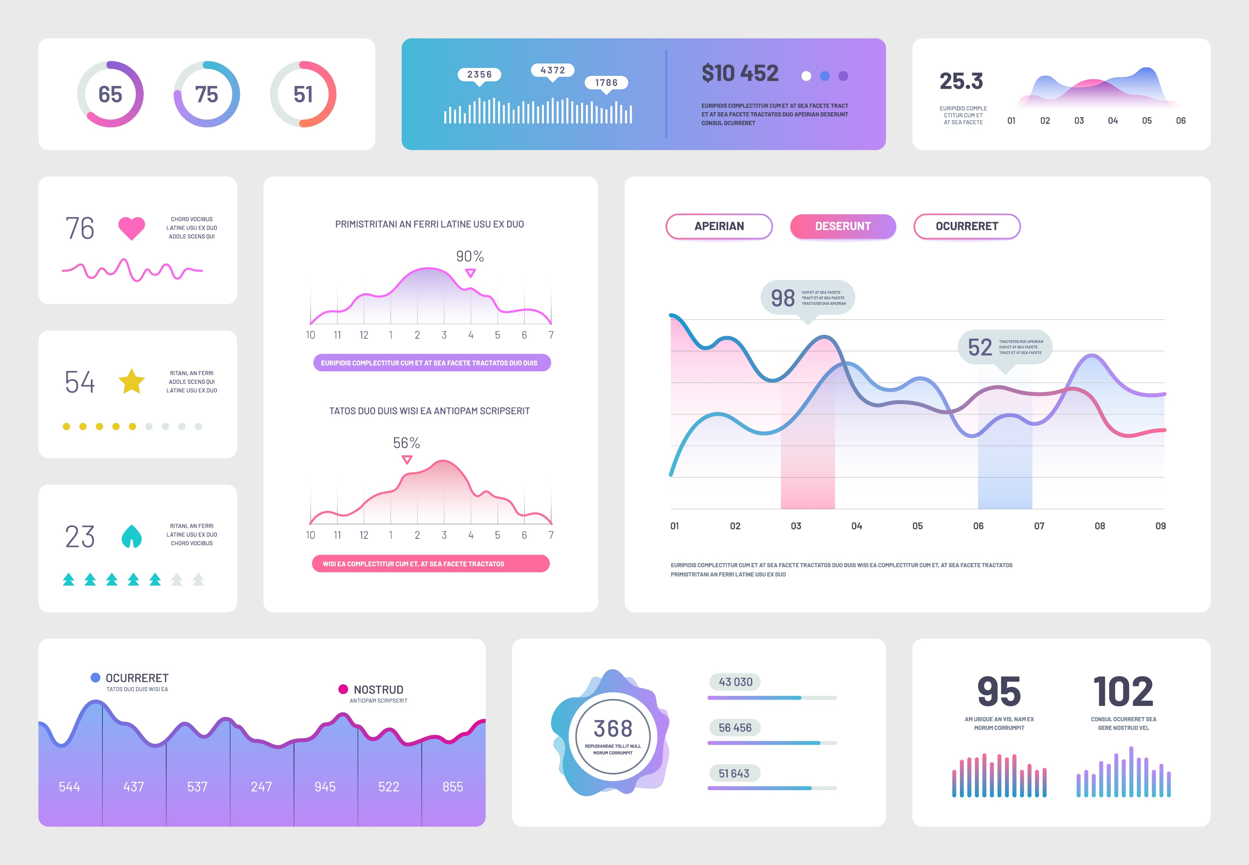
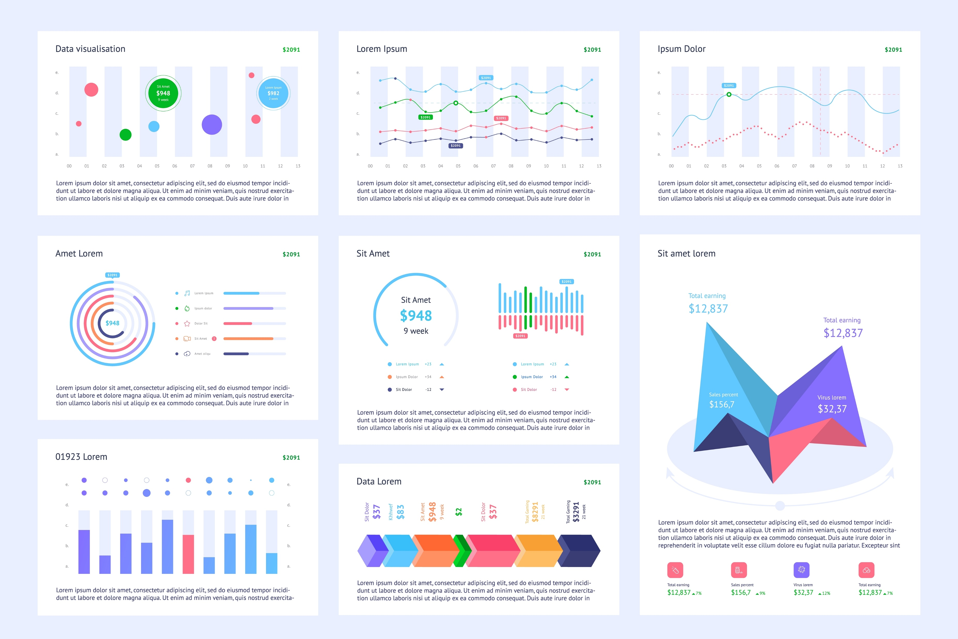
CONTENTS
BUSINESS OVERVIEW
DATA ANALYTICS
ESG & INTEGRATED REPORTING
MARKET
STRATEGY
BUSINESS DEVELOPMENT
BUSINESS TRANSFORMATION
CORPORATE GOVERNANCE
5
DATA ANALYTICS, VISUALIZATION & REPORTING SERVICES
Delivering Beautiful,
Easy-to-read Information
AI Konsult helps businesses integrate, aggregate, and analyze various data types from multiple data sources to address their most ambitious needs at department and enterprise levels.
Data Management & Integration
Services Included: Data Integration, Data Cleaning and Preprocessing, Big Data Analytics.
How we help you: We specialize in unifying data from various sources, ensuring it's cleaned, accurate, and actionable. We expertly handle large datasets, making them manageable and ready for analysis. This service benefits clients by providing a consolidated data foundation, crucial for accurate analytics and decision-making.
Advanced Analytics & AI Solutions
Services Included: Custom Analytics Solutions Development, Predictive Analytics, Prescriptive Analytics, Machine Learning and AI Integration, Data Mining and Pattern Recognition, Advanced Statistical Analysis.
How we help you: We develop tailored analytics models using advanced techniques, including AI and machine learning. We offer predictive insights and strategic recommendations based on data. Clients benefit from data-driven decision-making, enhanced forecasting abilities, and deeper insights into their operations and markets.
Visualization & Reporting
Services Included: Data Visualization, Dashboard and Report Designing, Real-Time Analytics.
How we help you: Creates intuitive visual representations of complex data sets and designs custom dashboards and reports for ongoing monitoring. This service is beneficial for clients who need to understand their data at a glance, offering accessible insights for stakeholders at all levels.
Business Intelligence & Self-Service Analytics
Services Included: Self-Service BI Tools Implementation, Descriptive Analytics, Customer Analytics, Supply Chain Analytics.
How we help you: We implements user-friendly BI tools, enabling non-technical users to conduct their own data analyses. We provide insights into customer behavior, supply chain efficiency, and overall business performance. Clients gain the advantage of self-reliance in data handling, leading to quicker, more informed decisions across the organization.
Compliance & Risk Management
Services Included: Risk Analytics, Regulatory Compliance and Data Governance.
How we help you: We focus on identifying and managing risks through data analysis and ensuring compliance with industry regulations. This service is crucial for clients to mitigate potential risks and adhere to legal standards, thereby protecting their reputation and operational integrity.
In the high-stakes environment of boardrooms and executive meetings, the clarity and precision of information can make the difference between a good decision and a great one.
AI Konsult specializes in data visualization consulting, focusing on making complex data easily understandable for business users through compelling visuals.
Our services include providing expert advice, implementing data visualization tools, and offering ongoing support. This approach allows businesses to convert extensive and intricate datasets into attractive and insightful visual representations. The goal is to address specific business queries and enable swift, data-driven decision-making with efficiency and clarity.
Making Data
Talk
We believe data should speak the language of leadership. Our specialty lies in distilling complex data into a narrative that is not just comprehensible but compelling to boards and management.
Data Visualization Excellence
Our visuals are crafted to be aesthetically pleasing and informative, ensuring that complex data is presented in an easy-to-digest format.
Customized Reporting Templates
Our visuals are crafted to be aesthetically pleasing and informative, ensuring that complex data is presented in an easy-to-digest format.
Actionable Recommendations
Our reports don't just inform; they advise. We provide clear, data-driven recommendations for your next steps.

Slide 7


CONTENTS
BUSINESS
OVERVIEW
ENTERPRISE DIGITAL HEALTH STRATEGY
HEALTHCARE DATA ANALYTICS
TELEHEALTH SOLUTIONS
ELECTRONIC HEALTH RECORDS (EHR)
ONLINE PHARMACY
CORPORATE GOVERNANCE
6
HelloDoc: Telehealth Solution
Telehealth has emerged as a transformative force in the healthcare industry, reshaping how medical care is delivered and accessed globally. At the forefront of this revolution in Africa is HelloDoc, a telehealth platform offering innovative solutions.
Telehealth refers to the use of digital technology to deliver healthcare services remotely. This includes consultations via video calls, remote monitoring, electronic data sharing, and more.
The adoption of telehealth has been accelerated by factors like technological advancements, the need for accessible healthcare in remote areas, and the recent global health crisis. Telehealth has shown great promise in improving healthcare access, reducing costs, and enhancing the efficiency of healthcare delivery.
Features of HelloDoc
Virtual Consultations: HelloDoc offers video and audio consultations, allowing patients to connect with doctors from any location.
Messaging System: Secure messaging enables patients to communicate with healthcare providers for follow-ups, clarifications, and quick consultations.
Appointment Scheduling: The platform includes an intuitive appointment scheduling system that allows patients to book, reschedule, or cancel appointments easily.
Prescription Management: Doctors can issue and manage prescriptions digitally, which can be directly sent to pharmacies or patients.
EHR Integration: HelloDoc integrates with Electronic Health Records (EHR), allowing seamless access and updating of patient records.
Remote Monitoring: For chronic conditions, HelloDoc enables remote monitoring of patient vitals, ensuring continuous care.
Healthcare Provider Network: A diverse network of healthcare professionals, including specialists and general practitioners, ensures comprehensive care availability.
Data Security & Compliance: Adherence to data protection regulations ensures patient information is securely handled. These include using HTTPS (the secure version of HyperText Transfer Protocol), SSL (Secure Socket Layer) encryption, and AES (Advanced Encryption Standard). compliance with the Health Insurance Portability and Accountability Act (HIPAA).
Health Education & Awareness: The platform also serves as a resource for health education, providing patients with valuable information about various health conditions.
HelloDoc is a telehealth platform that emphasizes ease of access to healthcare professionals regardless of location. It offers a comprehensive approach, including primary care, mental health, pediatrics, and diet & nutrition. The platform is designed to reduce stress and enhance physical, mental, and social health, offering online and in-person consultations, affordable services with follow-ups, and a general practitioner search for immediate assistance. It operates 24/7/365.

Slide 8
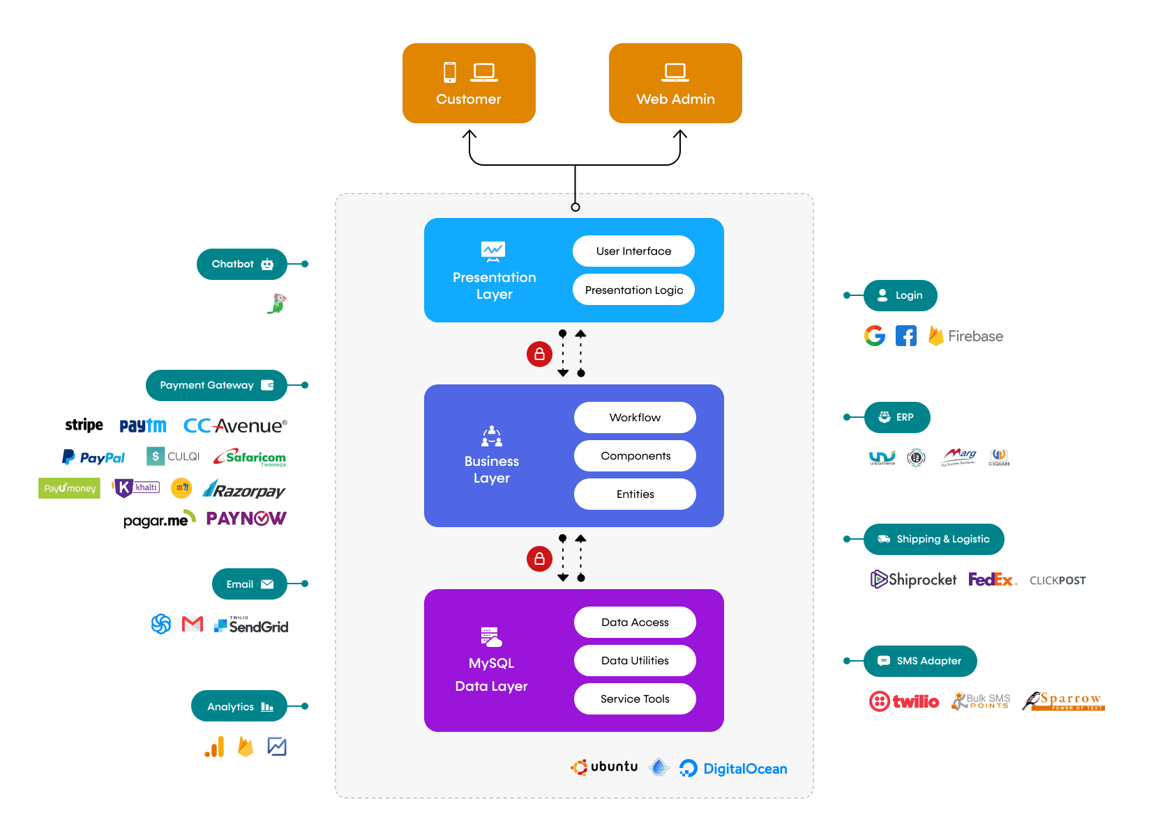
CONTENTS
BUSINESS
OVERVIEW
ENTERPRISE DIGITAL HEALTH STRATEGY
HEALTHCARE DATA ANALYTICS
TELEHEALTH SOLUTIONS
ELECTRONIC HEALTH RECORDS (EHR)
ONLINE PHARMACY
CORPORATE GOVERNANCE
7
HelloDoc: Telehealth Systems Architecture
The HelloDoc telehealth app's architecture is designed to support a seamless healthcare experience for customers while ensuring robust security and efficient operations for service providers.
The systems architecture of the HelloDoc telehealth app, is designed to provide a comprehensive and secure telehealth experience to its users.
Presentation Layer
User Interface: Incorporates the presentation logic that users interact with. It is designed to be intuitive and responsive to ensure a smooth user experience.
Business Layer
Workflow: Manages the application's operational flow, ensuring tasks are completed in the correct order.
Components: Individual modules that perform specific functions within the app.
Entities: Represents the data objects that are processed by the business logic components.
Data Layer
MySQL Database: Serves as the backbone for data storage, retrieval, and management.
Data Utilities: Tools that facilitate data manipulation and querying.
Service Tools: Utilities that provide services such as data backup, recovery, and security.
Integrations
Payment Gateways: Supports multiple payment services like Stripe, PayPal, etc., for financial transactions.
Login Services: Uses Firebase to integrate Google and Facebook sign-in options for user authentication.
ERP Systems: Connects with enterprise resource planning systems for backend business processes.
Shipping & Logistics: Partners with companies like Shiprocket and FedEx for logistical needs.
Communication: Employs services like Twilio for SMS and SendGrid for email notifications.

Slide 9



CONTENTS
BUSINESS
OVERVIEW
ENTERPRISE DIGITAL HEALTH STRATEGY
HEALTHCARE DATA ANALYTICS
TELEHEALTH SOLUTIONS
ELECTRONIC HEALTH RECORDS (EHR)
ONLINE PHARMACY
CORPORATE GOVERNANCE
8
Electronic Health Records (HER/EMR,PHI)
EHR (Electronic Health Records) Integration and Optimization as an advisory service provided by AI Konsult involves a comprehensive process that aims to enhance healthcare services through the effective use of digital records. Here's a detailed summary of this service:
EHR integration refers to the process of combining electronic health record systems with other healthcare software to create a seamless flow of information.
This integration enables healthcare providers to access and update patient records across different platforms, thereby improving the efficiency and accuracy of healthcare delivery.
Our advisory services focus on using AI algorithms to analyze and interpret large volumes of healthcare data, which helps in decision-making and personalized patient care.
Optimization of EHR Systems: The optimization process involves customizing the EHR system to meet the specific needs of a healthcare organization. This can include redesigning workflows, improving user interfaces, and ensuring that the system aligns with the clinical and administrative processes of the organization.
Data Management & Analysis: A significant part of EHR optimization is managing the vast amounts of data generated by healthcare providers. AI Konsult uses AI-driven tools to help in data categorization, analysis, and interpretation, making it easier for healthcare providers to access and use relevant information.
Enhancing Interoperability: One of the key challenges in EHR integration is ensuring interoperability, which is the ability of different systems and software to communicate and exchange data effectively. AI Konsult works on enhancing interoperability between various health IT systems to ensure smooth and error-free data exchange.
Compliance & Security: Ensuring compliance with healthcare regulations and maintaining the security of patient data are critical aspects of EHR integration. AI Konsult advises on best practices for compliance with laws like HIPAA (Health Insurance Portability and Accountability Act) and implements robust security measures to protect sensitive health information.
Training & Support: Implementing a new or optimized EHR system requires training for the healthcare providers. AI Konsult provides comprehensive training and support to ensure that the staff is comfortable and proficient in using the new system.
Continual Improvement & Updates: Technology in healthcare is continually evolving. AI Konsult stays abreast of the latest advancements in AI and EHR technologies to provide ongoing updates and improvements to the EHR systems, ensuring they remain effective and efficient over time.
Impact on Healthcare Delivery: The ultimate goal of EHR Integration and Optimization is to improve healthcare delivery. This is achieved through enhanced coordination of care, reduction in errors, improved patient outcomes, and increased efficiency in healthcare processes.
Customized Solutions: Every healthcare organization has unique needs and challenges. AI Konsult provides customized solutions that are tailored to address the specific requirements and goals of each organization they work with.
Availing Patient medical records (electronic Health Records & emergency Medical Records) and aggregation to enhance Healthcare Service Provider reviews.
Enablement of Telehealth and e-Prescribing and access to round the clock medical services.
Electronic health records (EHRs) are 200% more valuable than credit card data. Intellectual property is the bedrock of value that pharma companies rely on to develop lifesaving solutions. Protecting this kind of essential data from exploited vulnerabilities means securing your apps and cloud-based APIs with user-first experience at the edge
Scaling up Digitalization to enhance information sharing and avail data for analysis.

Slide 10
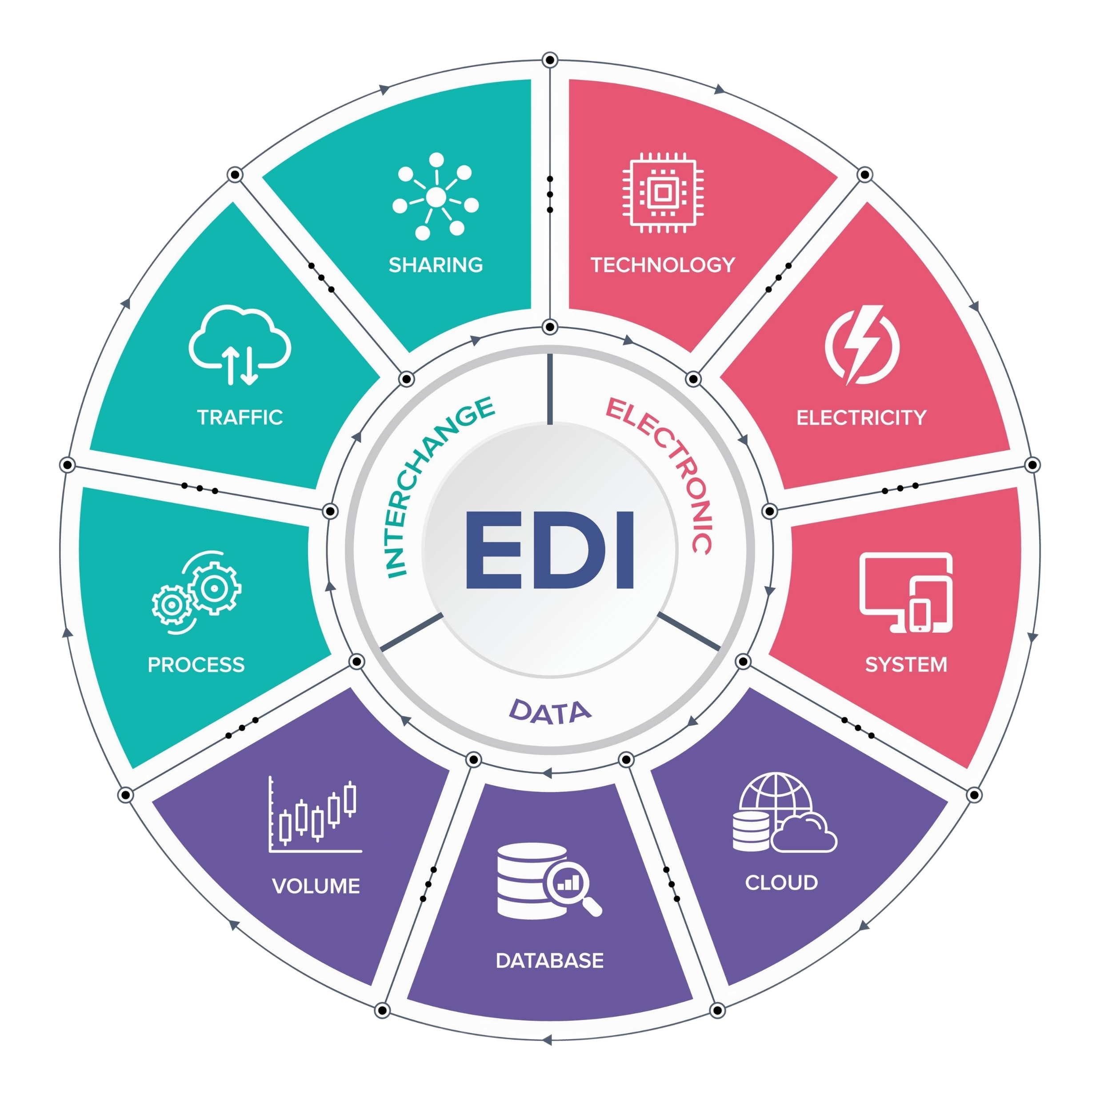
CONTENTS
BUSINESS
OVERVIEW
ENTERPRISE DIGITAL HEALTH STRATEGY
HEALTHCARE DATA ANALYTICS
TELEHEALTH SOLUTIONS
ELECTRONIC HEALTH RECORDS (EHR)
ONLINE PHARMACY
ELCTRONIC DATA INTERCHANGE (EDI)
9
Electronic Data Interchange (EDI)
Electronic Data Interchange (EDI) refers to the transfer of business documents between companies using a standardized electronic format. This method is a modern replacement for traditional paper-based documents like purchase orders and invoices. The primary aim of EDI is to enhance efficiency by automating transactions that were previously paper-based, thereby reducing time consumption and minimizing errors associated with manual processing.
In an EDI setup, data is transferred directly from one company's computer application to another's, eliminating the need for manual data entry or paper document exchange. EDI standards are crucial as they specify the exact location and sequence of information within the electronic document, ensuring consistent and accurate communication across different systems. This automated process enables quick data sharing, significantly faster than the time taken for processing paper documents or using other slower methods. As a result, EDI is a vital tool in streamlining business processes and improving overall operational efficiency.
How EDI benefits Healthcare?
EDI is utilized throughout industries, but the healthcare sector particularly benefits from its use because it provides a safe, standardized, and common way to communicate crucial documents between trading parties.
Streamlined procedures: Electronic data transfer uses internationally recognised standard formats that eliminate confusion and expedite corporate procedures. As will be discussed further in this blog, the HIPAA regulations (link) have been crucial in creating international standards for healthcare messages.
Increased effectiveness: The use of standards in EDI guarantees that transactions adhere to tight rules based on the format, which streamlines and streamlines the process. This shortens the processing time and significantly decreases errors that arise from manual document exchange and may affect supply, breach regulations, or result in other problems. Additionally, EDI enables attachments, which are highly helpful for business dealings in the healthcare industry.
Decreased cost: By enabling document exchange through the use of EDI technology, that allows messages to be sent between two systems, you end up saving money on the exchange of paper-based documents. The automated document sharing also saves your resources time, allowing them to concentrate on other crucial activities.
Improved security: When used for healthcare transactions, EDI guarantees the safe transfer of paperwork such insurance claims, patient reports, and billing data while upholding legal requirements. These exchanges take place only between authorized individuals and are done so utilizing secure protocols.
Lesser errors: If your ERP system is coupled with EDI solutions, you can flag any mistakes before sharing the document with trading parties or while retrieving it. Some solutions, like EDI Studio, also provide you the choice of quickly fixing issues.
Future of EDI in healthcare?
The future of Electronic Data Interchange (EDI) in healthcare promises to be an exciting and transformative journey, leveraging technology to enhance various aspects of healthcare delivery and management. EDI, the computer-to-computer exchange of documents in a standard electronic format between business partners, has been a pivotal component in healthcare for tasks like billing, claims processing, and more. Looking ahead, several key developments and trends are likely to shape its trajectory:
Integration with Emerging Technologies: The integration of EDI with advanced technologies like Artificial Intelligence (AI) and Machine Learning (ML) can revolutionize how data is processed and utilized in healthcare. AI algorithms can assist in analyzing large volumes of EDI data to identify patterns, predict trends, and make informed decisions, enhancing areas like patient care, resource allocation, and treatment outcomes.
Automation and Efficiency: Automation of administrative tasks through EDI will continue to be a focus, reducing manual errors, saving time, and cutting costs. This will allow healthcare professionals to focus more on patient care rather than administrative tasks.
Real-Time Data Processing: The evolution of EDI towards real-time data processing will enable quicker decision-making in critical healthcare scenarios. This could streamline operations like insurance claims processing, patient admissions, and emergency response, making the healthcare system more efficient and responsive.
The future of EDI in healthcare is not just about technological advancements but also about creating a more interconnected, efficient, and patient-centric healthcare ecosystem. This evolution will require collaboration among tech developers, healthcare providers, policymakers, and patients to realize the full potential of EDI in transforming healthcare.

Slide 11



CONTENTS
BUSINESS
OVERVIEW
ENTERPRISE DIGITAL HEALTH STRATEGY
HEALTHCARE DATA ANALYTICS
TELEHEALTH SOLUTIONS
ELECTRONIC HEALTH RECORDS (EHR)
ONLINE PHARMACY
CORPORATE GOVERNANCE
10
PharmacyExpress: Online Pharmacy
PharmacyExpress is an innovative online pharmacy service that stands at the forefront of healthcare and prescription medication management in the digital age. This service represents a significant advancement in the pharmacy sector, bringing the ease and accessibility of online shopping to pharmaceutical services.
Here are some key features of PharmacyExpress:
Service Overview: PharmacyExpress allows customers to order their prescription medications through an online platform. This modern approach to pharmaceutical services prioritizes convenience and accessibility, backed by a reliable delivery system for prompt distribution of prescriptions.
Prescription Management: Customers have the option to directly send prescriptions from healthcare providers to PharmacyExpress or transfer prescriptions from other pharmacies. The platform simplifies the process of managing and refilling prescriptions, enhancing user convenience.
Insurance & Pricing: The service is compatible with a broad array of health insurance plans and provides transparent pricing for those without insurance. PharmacyExpress offers a cost comparison tool to help customers decide between insurance co-pay and out-of-pocket expenses, ensuring cost-effective choices.
Privacy & Compliance: Adhering to stringent healthcare privacy laws and standards, PharmacyExpress places a high priority on safeguarding customer health and personal information, employing advanced security protocols.
Member Benefits: PharmacyExpress may offer benefits such as fast shipping or medication discounts to members of its service or loyalty program, adding value to the customer experience.
Pharmacist Support: The service ensures that customers have round-the-clock access to professional pharmacists, providing a platform for consultation and answers to medication-related queries.
Industry Impact: The introduction of PharmacyExpress reflects a growing trend in the healthcare sector, where digital innovation is leveraged to streamline services and enhance patient care.
Service Availability: PharmacyExpress aims to cater to a wide audience, with availability subject to regional regulations and licensing agreements, ensuring broad reach and accessibility.

Slide 12

Disclaimer & Legal Notice
General
Please note that the information provided in this document by Artificial Intelligence (Pty) Ltd / AI Konsult, including its partners and associates, is for general informational purposes only. All efforts have been made to ensure the information is current and accurate; however, AI Konsult does not guarantee the completeness, accuracy, or reliability of this information. The content provided should not be solely relied upon for making decisions without consulting primary or more accurate, more complete, or more timely sources of information.
Confidentiality
Any information contained within this document is confidential and intended solely for the use of the individual or entity to whom it is addressed. Unauthorized use, disclosure, or copying of this document or any part thereof is strictly prohibited and may be unlawful. If you have received this document in error, please notify AI Konsult immediately.
Intellectual Property Rights
This document, including all content and graphics, is the intellectual property of Artificial Intelligence (Pty) Ltd / AI Konsult, protected under the laws of Botswana. Unauthorized reproduction, distribution, or modification of this document, in whole or in part, without the prior written consent of AI Konsult is prohibited and may constitute a violation of intellectual property laws.
Limitation of Liability
In no event will AI Konsult, its partners, or associates be liable for any loss or damage including without limitation, indirect or consequential loss or damage, arising from the use of or reliance on the information provided in this document.
Governing Law
This disclaimer and legal notice shall be governed by and construed in accordance with the laws of Botswana. Any disputes arising out of or in relation to this notice shall be subject to the exclusive jurisdiction of the courts of Botswana.
Changes
This notice is subject to changes and updates at the discretion of AI Konsult without prior notice. Your use of this document signifies your acceptance of this disclaimer and legal notice.
Privacy
Client Privacy Protection
AI Konsult undertakes an unwavering commitment to maintain the highest level of confidentiality with respect to the information and proprietary data of our esteemed clients.
We pledge to rigorously safeguard and protect sensitive business information from any unauthorized access, usage, or dissemination.
Non-Disclosure of Client Identities
We assure our clients that AI Konsult shall never advertise, disclose, or reveal the identities of the clients we have served or currently work with.
This practice ensures that our clients' strategic initiatives, competitive edge, and market positioning remain strictly confidential.
Core Values and Ethical Foundation
Integrity, Security, and Trust
Our operational ethos is firmly entrenched in the principles of integrity, security, and trust.
AI Konsult is resolutely committed to adhering to the highest standards of ethical conduct, promoting transparency, and fostering a culture of trust among our clients, partners, and stakeholders.
Client-Centric Engagement Approach
Singular Client Focus: In our pursuit of delivering exceptional value, AI Konsult maintains an exclusive focus on serving one client at a time. This distinctive approach empowers us to marshal our collective expertise, knowledge, and resources towards devising bespoke strategies tailored to our client's unique objectives.
Advisory Vigilance and Ethical Prudence
Comprehensive Brief and Ethical Parameters: We uphold a stringent criterion for engagement, ensuring that project timelines and briefs align with our commitment to providing actionable insights while adhering to ethical standards and quality.
We reserve the right to decline opportunities that lack comprehensive information or deviate from ethical norms, prioritizing the well-being of our clients and the responsible utilization of information.
Stakeholder Welfare and Legal Compliance
Social Responsibility: AI Konsult remains unwavering in its dedication to societal welfare.
We pledge to refrain from engaging with entities or individuals that have been legally proven to commit serious infractions against our values.
Our commitment extends towards safeguarding the world; environment, humanity, animals, and marginalized communities.
BUSINESS
ADVISORY SERVICES PROFILE
AI KONSULT
Contact Person : Scelo Hlope I Business Lead
Contact Number : (+267) 71-333-551
E-mail: scelo@ai.co.bw
Address: Plot 7372 , Unit 2B , 23 Square 30 Phakalane | Gaborone | Botswana
A DIVISION OF ARTIFICIAL INTELLIGENCE (Pty) Ltd
BW00002314974

